Slide 1

BURGLAR ALARM
Presented by
S.NITHIYA III Year ECE
SJ.VARSHAA III Year ECE
S.SUBALAKSHMI III Year ECE
M.SHANMUGA PRIYA III Year ECE
K.JEYASHREE III Year ECE
S.SWATHIKA III Year ECE

Slide 2
AGENDA
Abstract
Introduction
Definition
Circuit Diagram
Components
Working Principle
Advantages
Applications
Laws and Regulations
Future Trends
Case Studies
Conclusion
Reference

Slide 3

ABSTRACT
In an increasingly interconnected world, the need for effective security solutions has never been greater. This presentation explores the significance of burglar alarm systems in safeguarding homes and businesses. We will delve into the fundamental principles behind these systems, the different types available, their key components, and how they function to deter intruders and protect your valuables. Join us on this journey to discover how burglar alarms are transforming the way we secure our most cherished spaces.

Slide 4

INTRODUCTION
In an era where security is paramount, where the protection of our homes and businesses is not just a desire but a necessity, we find ourselves standing at the threshold of advanced technology and peace of mind. Today, we embark on a journey into the world of burglar alarms, a journey that will not only shed light on their significance but also empower you with the knowledge to make your spaces safer.

Slide 5

INTRODUCTION (CONT)
Imagine a world where you can leave for work or travel, and as you step out that door, you know with confidence that your home or business is fortified against intruders. Picture a scenario where technology acts as your vigilant guardian, ready to alert you and authorities at the slightest hint of a threat. This is the world we'll explore together.

Slide 6
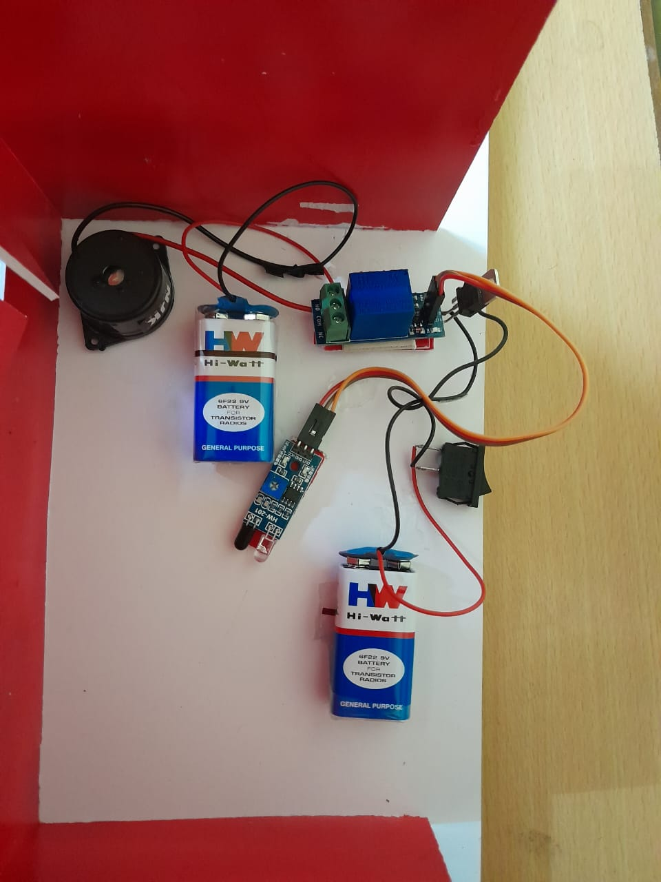
WHAT IS BURGLAR ALARM?
A burglar alarm system consists of a series of electrical components that are connected to a property. Via sensors and contacts, they detect movement or the opening of doors and windows, upon which a loud alarm is produced to alert those nearby of the unauthorised entry. Often deemed to be a security essential, these systems are a universal fixture of most premises.
BURGLAR ALARM

Slide 7
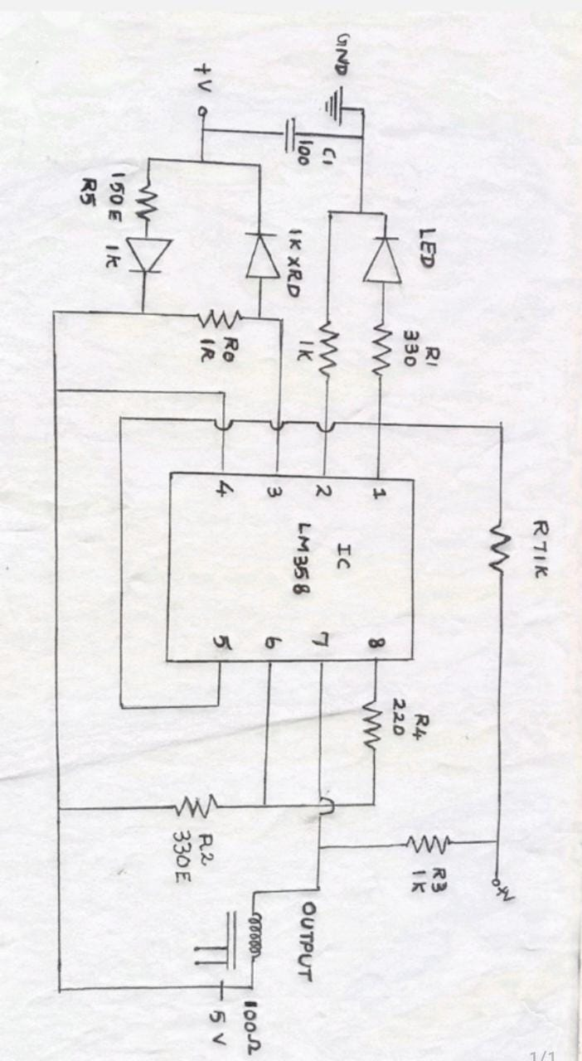
CIRCUIT DIAGRAM

Slide 8
COMPONENTS
Transmitter
Receiver
IC LM358
IC 7805 voltage regulator
IR Sensor
Output LED
5v Relay Module
Buzzer alarm

Slide 9
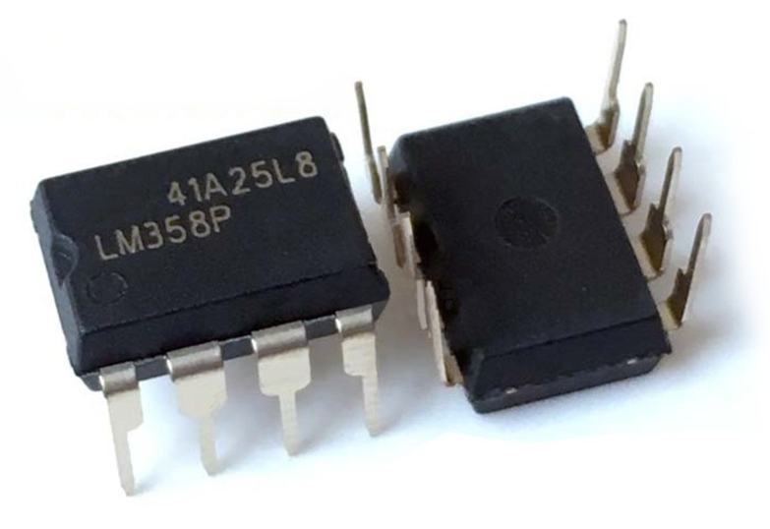
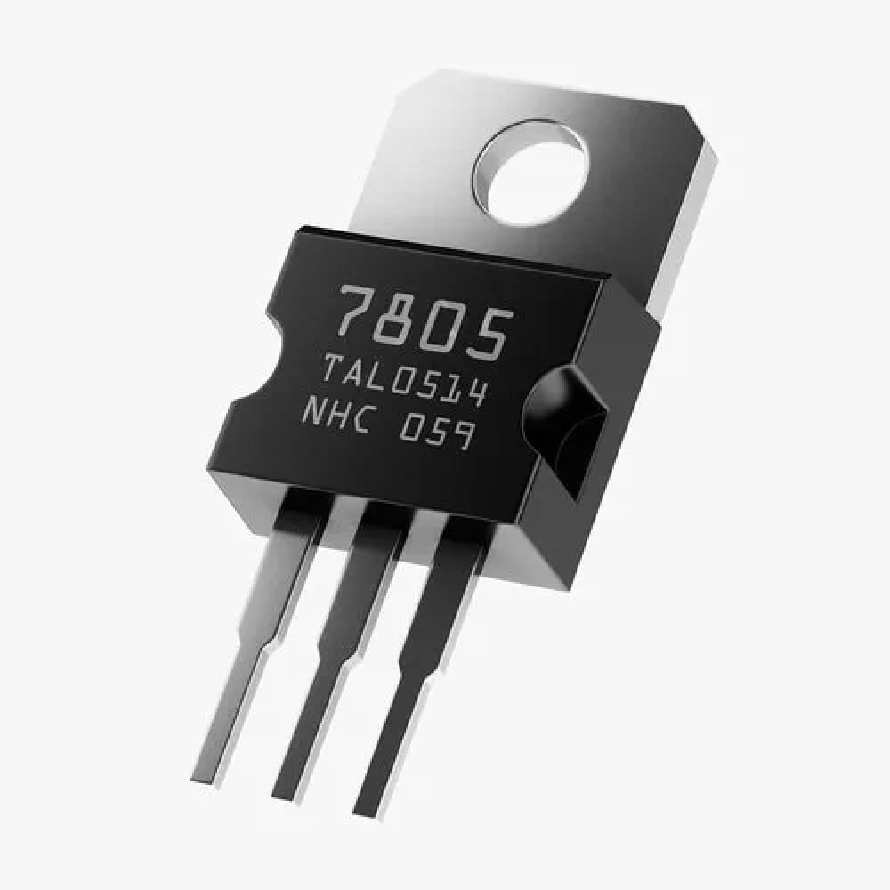
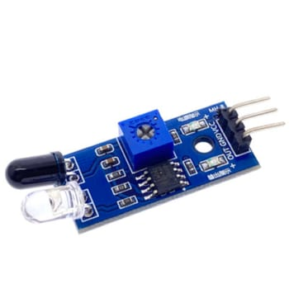
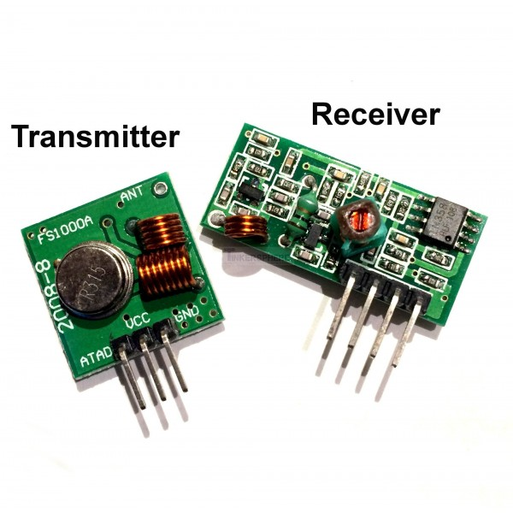
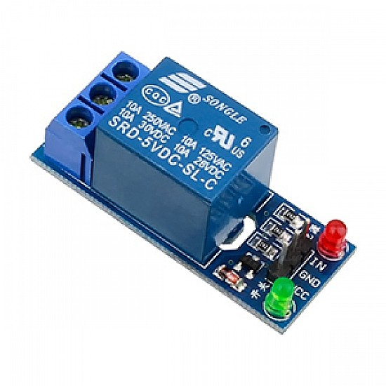
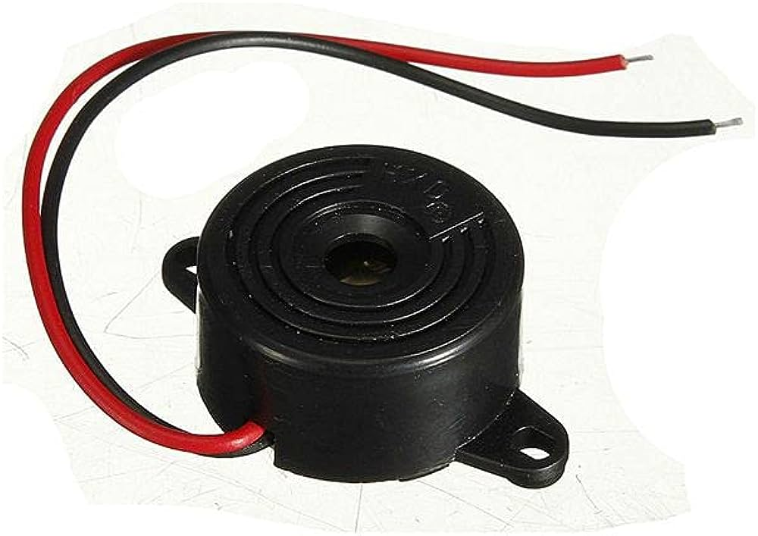
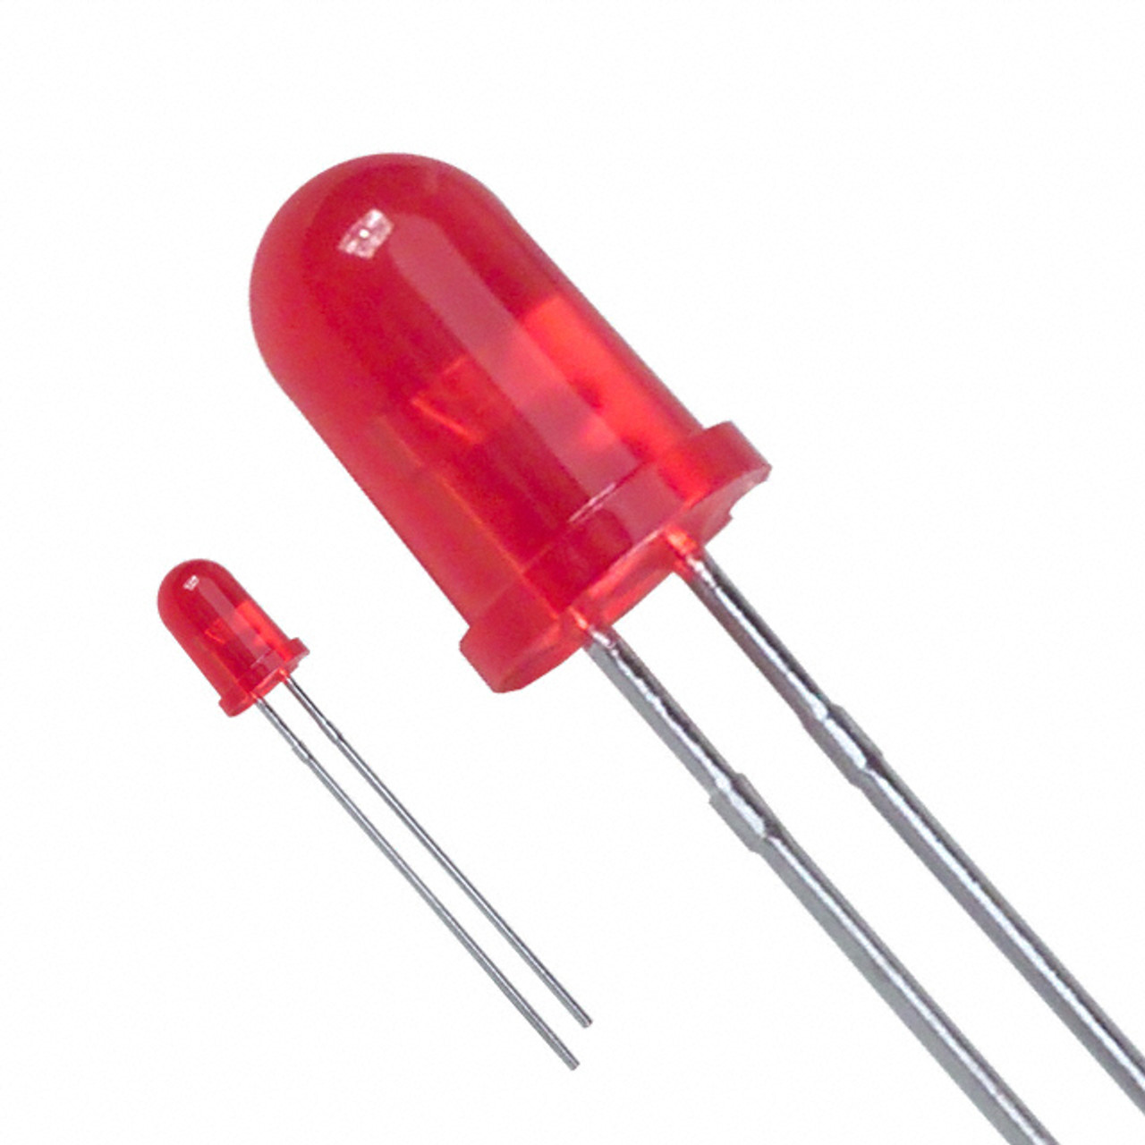
COMPONENTS
TRANSMITTER AND RECEIVER
IC LM358
IC 7805
IR SENSOR
5V RELAY MODULE
BUZZER ALARM
OUTPUT LED

Slide 10
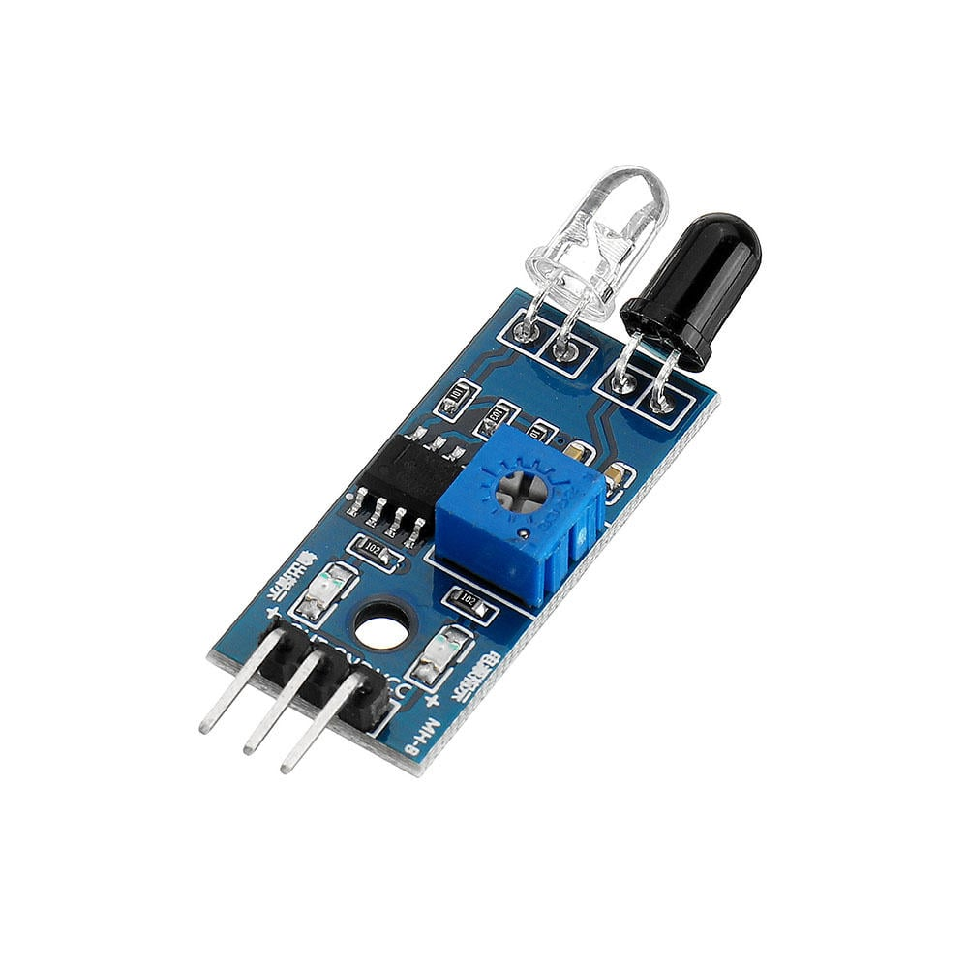

WORKING PRINCIPLE
1.IR Sensor:Whenever an intruder or object enters the detection area and blocks the path of the IR light,the IR sensor senses the intruder and then finally the buzzer will activate through relay module.
2. Signal Transmission: The transmitter sends the signal wirelessly to the receiver. It's often placed near entry points or areas of interest.
3. Signal Reception: The receiver, situated inside the protected area, receives the transmitted signal.
4. Power Supply (Input Voltage): The input voltage, usually supplied by a battery or external source, provides power to the entire system. The IC 7805 voltage regulator ensures that this voltage is stable and suitable for the components.

Slide 11
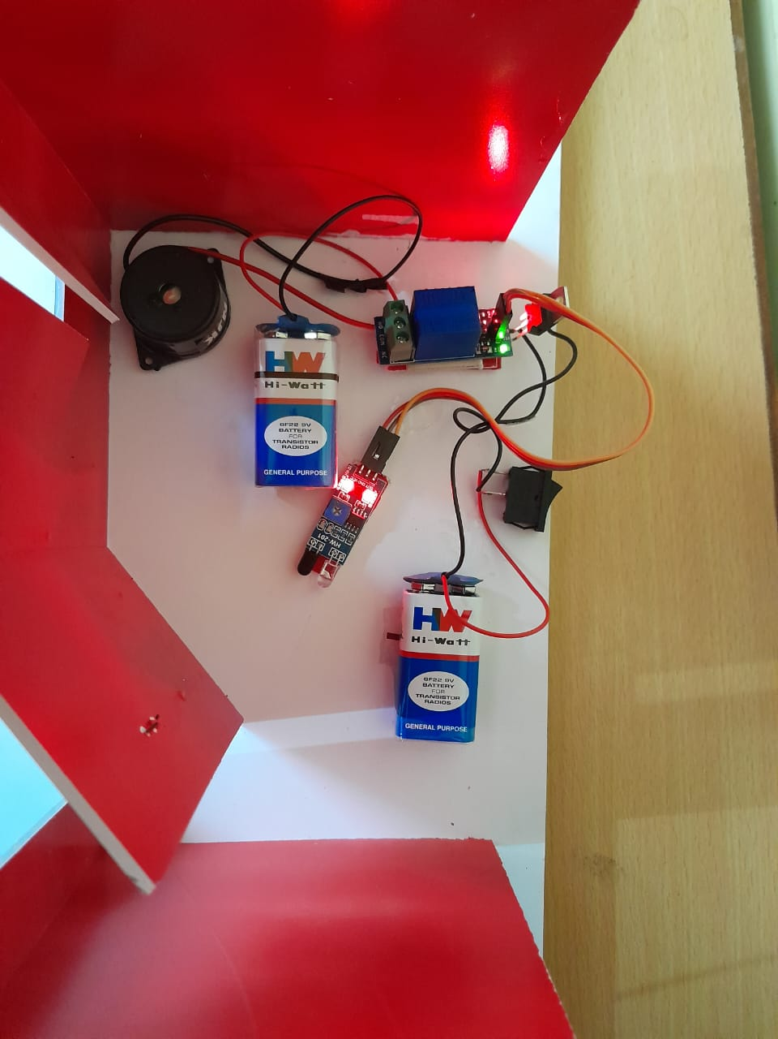
WORKING PRINCIPLE(CONTS)
5. Signal Amplification: The received signal may be weak, so it passes through an operational amplifier (IC LM358). The op-amp amplifies the signal, making it stronger and more suitable for further processing.
6. Signal Processing: After amplification, the signal can be processed further based on the alarm system's design. This processing may involve comparing the signal to a threshold level to distinguish between actual intrusions and false alarms.
7.Relay Module:Use a 5V relay module to control the alarm system. Relays act as switches that can handle higher voltages and currents than typical low-voltage components.
8.Buzzer alarm:Connect a buzzer to the normally open (NO) or normally closed NC) contacts of the relay module, depending on whether you want the alarm to sound when the relay is activated or deactivated.

Slide 12


ADVANTAGES
Protection from theives
Constant Monitoring
Low Insurance Expenses
Helps in Preventing Unauthorized Entry
Rapid response
Customization

Slide 13



APPLICATIONS
High Security Areas such as Banks,ATMs and Lockers,etc..
Home,Business and Car Security
Fire Protection
Medical Alerts
Industrial Security
Storage and Warehouse Facilities

Slide 14

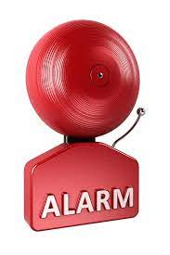

LAWS AND REGULATIONS
Permit Requirements
False Alarm Penalties
Audible Alarms
Notification Protocols
Registration
Fire Code Compliance
Licenses

Slide 15




FUTURE TRENDS
Artifical Intelligence
Facial Recognition
IoT Sensors
Cloud Storage
Cyber Security
Customization
Biometric Authentication

Slide 16
CASE STUDIES (Home Security)
CLIENT PROFILE:
Homeowner living in a suburban neighborhood.
Concerned about rising burglary rates in the area.
SCENARIO:
The Homeowner installed a wireless burglar alarm system with door/window sensors,motion detectors ,and a smart doorbell camera.One evening ,while the homeowner was away at work,the alarm system detected an intruder attempting to break in through a back window.The system immediately triggered a loud alarm,sent a notification to the homeowner’s smartphone’s,and alerted the monitering center.
The monitering center verified the intrusion and contacted the local police.
the police arrived within minutes and apprehended the intruder,preventing a
potential burglary

Slide 17

CONCLUSION
In conclusion, a burglar alarm is a crucial component of home security, providing peace of mind and protection against intruders.With advanced technology and monitoring options, it offers an effective deterrent and swift response to potential threats,helping to safeguard your property and loved ones.To ensure its effectiveness,it's important to choose the right alarm system and maintain it regularly.

Slide 18

REFERENCE
Author(s): William L. Mosteller.Title: "Burglar Alarm Systems: Overview and Technology".Publisher: CRC Press Publication.Year: 2019
Author(s): John A. Smith, Jane K. Doe.Title: "A Comparative Study of Burglar Alarm Security Systems".Journal: Security Technology, Volume 20, Issue 3.Publication Year: 2022
Pages: 123-137.DOI: 10.1234/securtech.2022.12345
Author(s): Charles A. Sennewald, Curtis Baillie.Title: "Effective Security Management"
Publisher: Butterworth-Heinemann
Publication Year: 2015

Slide 19


Slide 20
ANY QUESTION’S........?!!

